Slide 1
Test 1 revision
CHEMISTRY UNITS 1 & 2

Slide 2
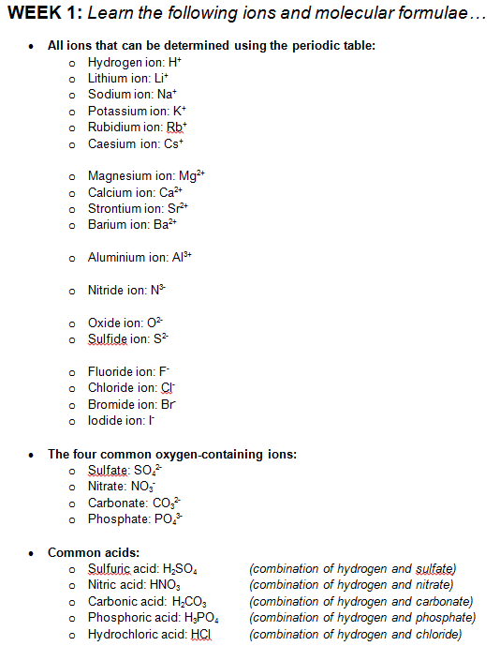
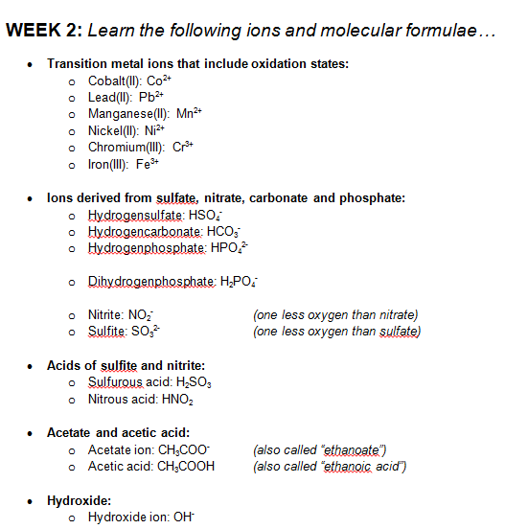
IONS

Slide 3
IONS
Do you know how to write the formulas of ions such as…
  Barium hydroxide
  Calcium phosphate
  Iron(II) sulfide
  Chromium(III) carbonate
  Magnesium hydrogensulfate
  Aluminium acetate
If not, is the problem…
  a) That you don’t know the method for writing the formulas?
  b) That you haven’t learnt the ions?
  For option (a) you need to see me for help. For option (b) you need to study.

Slide 4
COVALENT MOLECULES
You should know how to write systematic names using prefixes
(di = 2, tri = 3, tetra = 4, etc)
  Carbon dioxide = CO₂
  Sulfur hexafluoride = SF₆
  Dinitrogen tetroxide = N₂O₄
You should know formulas of these non-systematic names
  Nitric acid = HNO₃
  Sulfuric acid = H₂SO₄
  Carbonic acid = H₂CO₃
  Phosphoric acid = H₃PO₄
  Hydrochloric acid = HCl
  Acetic acid = CH₃COOH
  Sulfurous acid = H₂SO₃
  Nitrous acid = HNO₂

Slide 5
RELATIVE MASSES
Relative atomic mass:
  Mass of an atom relative to 1/12th of a carbon-12 atom
  e.g. A_{r}(H) = 1.008
Relative molecular mass:
  Mass of a covalent molecule relative to 1/12th of a carbon-12 atom
  e.g. M_{r}(H₂O) = 1.008 x 2 + 16 = 18.016
Relative formula mass:
  Mass of an ionic formula relative to 1/12th of a carbon-12 atom
  e.g. M_{r}(NaCl) = 22.99 + 35.45 = 58.44

Slide 6
MOLAR MASS
Mass of 1 mole of a chemical substance
  Symbol: M
  Unit: g mol⁻¹
  Same value as relative atomic/molecular/formula mass
    M_{r}(H₂O) = 18.016 M(H₂O) = 18.016 g mol⁻¹
  e.g. Calculate the molar mass of barium fluoride (BaF₂)
  M(BaF₂) = 137.3 + 19 x 2
  = 175.3 g mol⁻¹

Slide 7
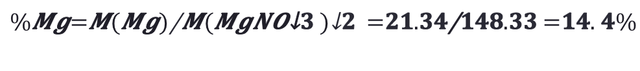
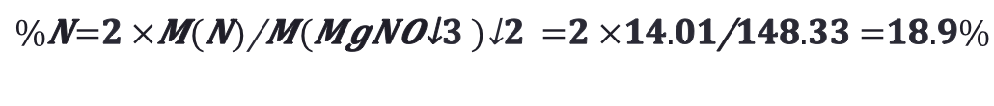
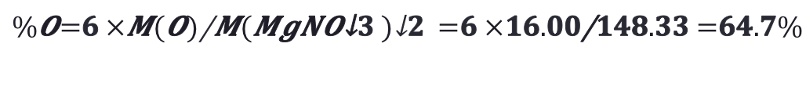
PERCENTAGE COMPOSITION
Percentage by mass of each element in a compound.
  e.g. Calculate the percentage by mass of each element in magnesium nitrate (Mg(NO₃)₂).
  M(Mg(NO₃)₂) = 148.33 g mol⁻¹

Slide 8
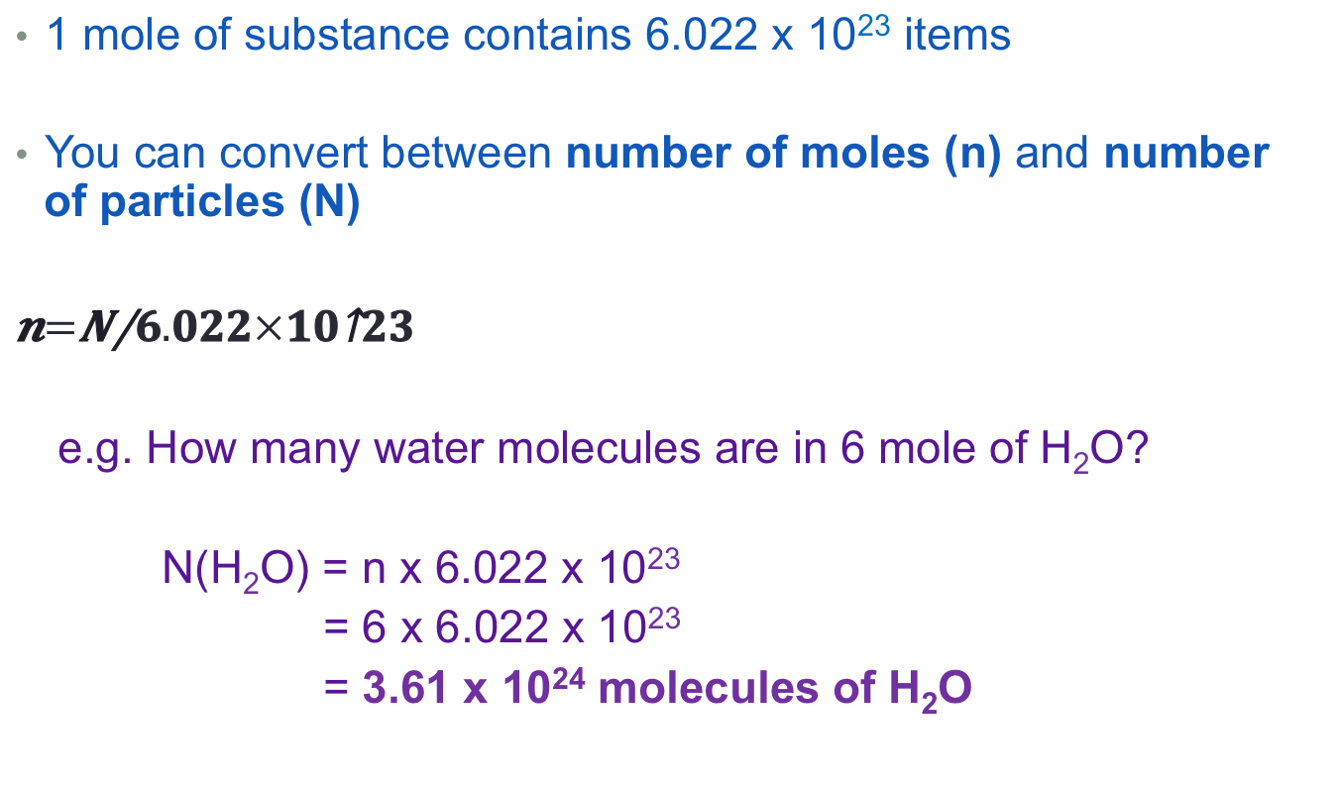
MOLES AND PARTICLES

Slide 9
MOLES AND CHEMICAL FORMULAE
The chemical formula tells you the number of atoms in a molecule or compound.
  E.g. H₂O means two hydrogen atoms per one oxygen atom
This can be used to find number of moles of individual atoms if you know the moles of the whole compound (or vice versa)
  e.g. How many moles of O atoms are in 6.22 mol of CaCO₃?
  Each CaCO₃ contains three oxygen atoms.
  Therefore…
  n(O) = 3 x n(CaCO₃)
  = 3 x 6.22
  = 18.7 mol

Slide 10
EMPIRICAL FORMULA
Empirical formula is the simplest ratio of atoms in a chemical formula
  e.g. Empirical formula of hexene (C₆H₁₂) is CH₂.
Empirical formula can be determined by calculating the ratio of moles in a chemical substance
 | Mg | F
Mass (g) | 39.0 | 61.0
Moles (mol) (n = m/M) | 1.60 | 3.21
Mole ratio (Divide by smallest n) | 1.0 | 2.0
Empirical formula is MgF₂

Slide 11
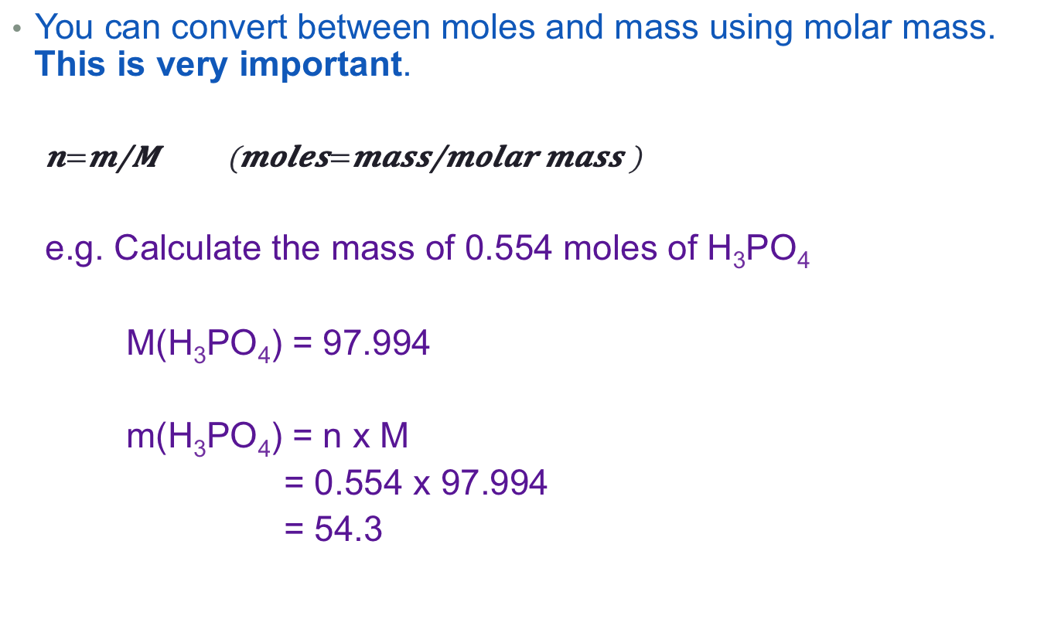
MOLES AND MASS

Slide 12

USING BALANCED EQUATIONS
The numbers in a balanced equation relate the number of moles of substances when they react.
  2 C + 1 O₂ → 2 CO₂
  2 moles of C + 1 mole of O₂ → 2 moles of CO₂
  e.g. How many moles of carbon (C) can react with 0.588 moles of oxygen gas (O₂)
  For every 1 mole of oxygen there are 2 moles of carbon.
  Therefore…
  n(C) = 2 x n(O₂)
  = 2 x 0.588
  = 1.18 mol

Slide 13



PUTTING IT ALL TOGETHER
You can combine all of the equations we have learnt to take multi-step problems.
How many grams of hydrogen gas are produced when 0.62 g of magnesium is placed into hydrochloric acid? Mg + 2 HCl → H₂ + MgCl₂
Ammonia is produced from the reaction between hydrogen and nitrogen gas. 6 H₂ + N₂ → 2 NH₃. What mass of nitrogen and hydrogen would be needed to produce 500 kg of ammonia.
Mass of substance 1
Mass of substance 2
Moles of substance 1
Moles of substance 2

